Slide 1

Score-Inator
AI-Powered Scoring Assistant for Google Agentic Hackathon
Presented by Team ScoreKeepers:
Bhuvanesh Balaji and Manimaran Govindarajan

Slide 2


The Challenge
Traditional Hackathon Judging Issues
Inconsistent scoring across judges
Human evaluators apply different criteria and weightings, leading to unpredictable results
Time-intensive evaluation processes
Manual assessment of multiple projects creates bottlenecks and delays
Limited technical depth analysis
Surface-level reviews miss critical architectural and implementation details
Subjective bias in assessments
Personal preferences influence scores rather than objective merit
Score-Inator transforms project evaluation with AI-powered precision and comprehensive multi-dimensional analysis.

Slide 3




Meet Our AI Agent Orchestra
Community Manager
Architect Agent
Evaluates community impact, inclusiveness, and real-world adoption potential with deep market analysis
Reviews scalability, design patterns, and technical feasibility through comprehensive code analysis
Scout Agent
Assesses innovation, uniqueness, and problem-solution alignment with competitive landscape mapping

Slide 4
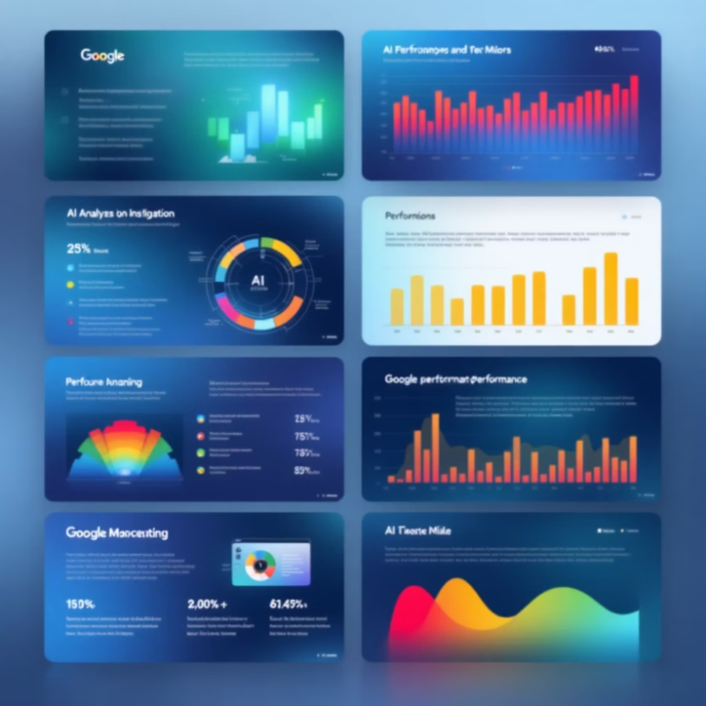

Specialized Agent Expertise
AI Contributor Agent
Ensures proper AI usage, originality assessment, and ethical considerations with advanced plagiarism detection
Code authenticity verification
AI tool integration analysis
Ethical AI implementation review
Pitch Deck Analyst
Validates clarity, storytelling effectiveness, and presentation quality through comprehensive communication metrics
Visual design assessment
Narrative structure evaluation
Audience engagement potential

Slide 5







Technologies Used
AI Development Kit (ADK)
Python
Gemini 1.5 Flash
Foundation for crafting custom AI agents and intelligent applications.
Core language for AI/ML development and scripting automation.
Google's efficient multimodal AI model for rapid processing and scalable solutions.
Git
Google Cloud
Qwiklabs
Distributed version control system for collaborative development and code management.
Scalable cloud infrastructure hosting AI services and deployments.
Hands-on labs for practical learning and skill validation on Google Cloud.
Cloud Shell
Browser-based command-line environment for managing cloud resources.

Slide 6








How Score-Inator Works
Project Submission
Teams submit their hackathon projects through our streamlined interface for comprehensive evaluation
Multi-Agent Analysis
Five specialized agents analyze different project dimensions simultaneously with deep technical expertise
Orchestrator Integration
Central agent normalizes, validates, and aggregates all scores into comprehensive final rating
Each agent provides structured feedback with scores (0-100%), detailed reasoning, and actionable improvement suggestions for continuous learning.

Slide 7



Transforming Hackathon Evaluation
100% Consistency
5X Faster
360° Comprehensive
Standardized evaluation criteria across all projects eliminates judge variability
Dramatically reduced judging time from hours to minutes per project
Multi-dimensional project analysis covers technical, business, and presentation aspects
Score-Inator delivers objective, scalable, and comprehensive project evaluation that empowers both judges and participants with actionable insights.

Slide 8
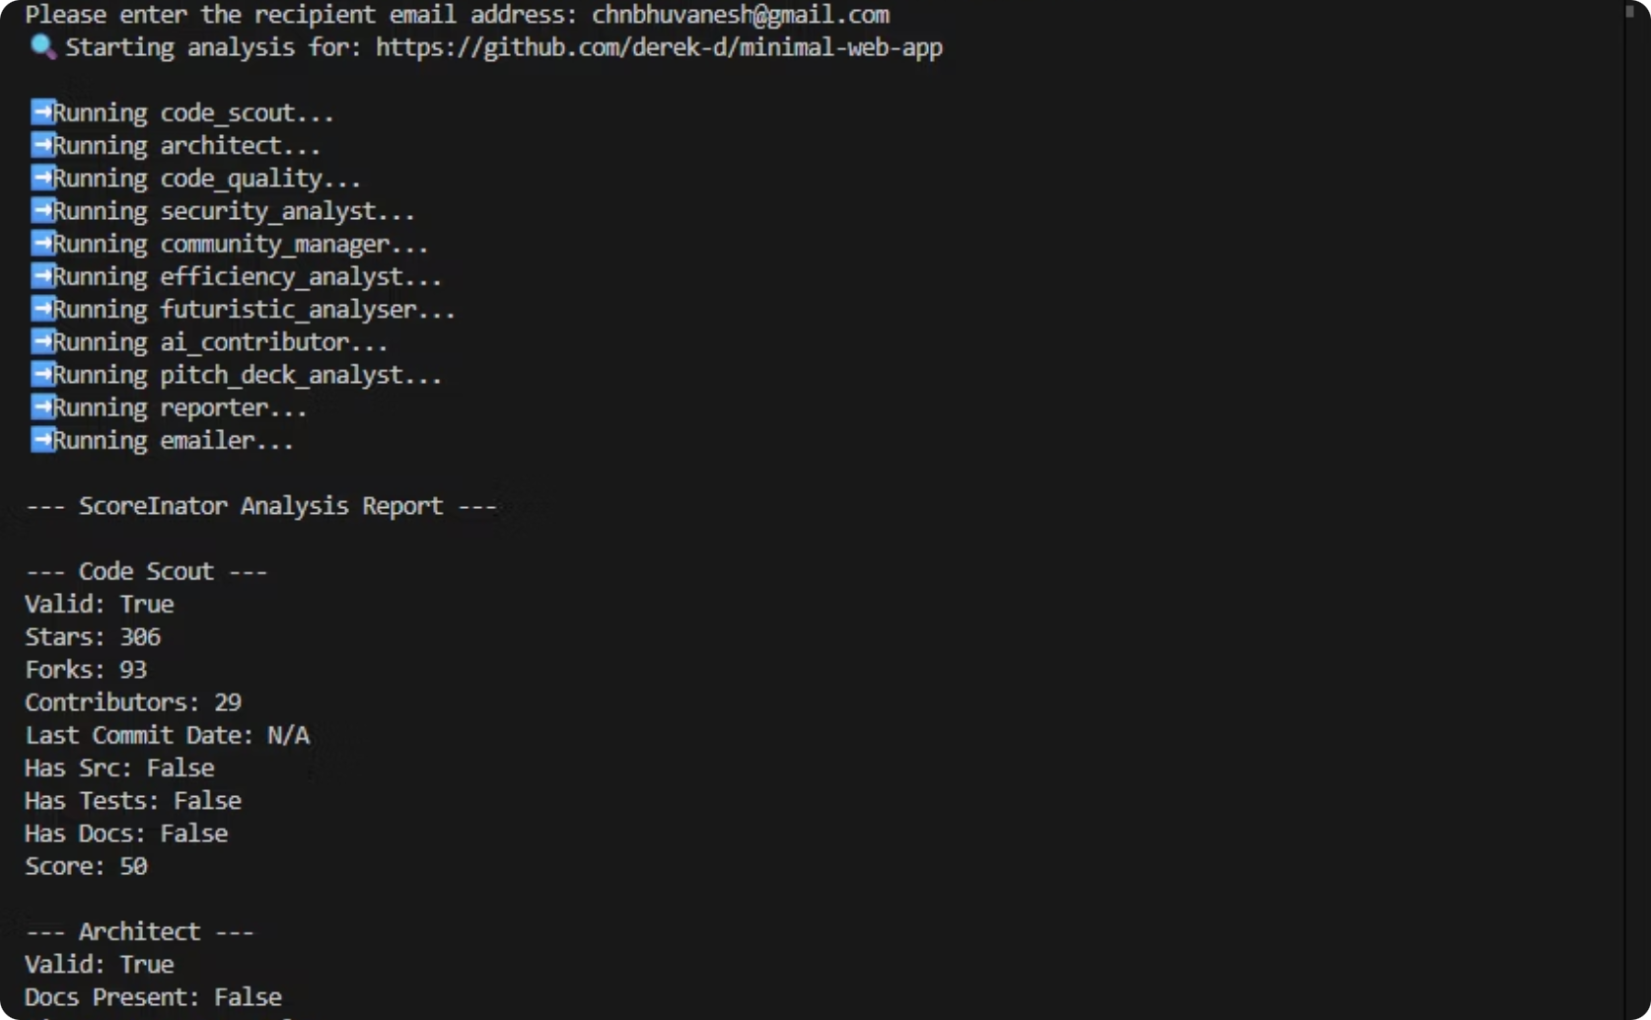
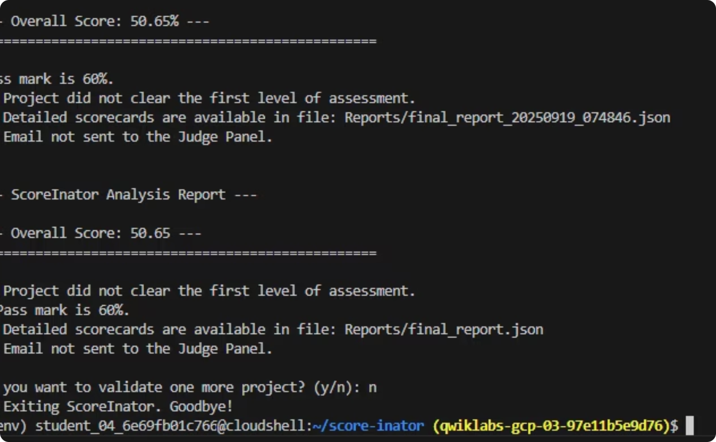
Score-Inator in Action
Comprehensive Scoring Overview
Detailed Agent Analysis & Validation
This screenshot offers a clear overview of scoring results and detailed analysis. Judges quickly grasp key metrics to identify top projects.
This view details agent analysis, showing how each score is derived. It provides granular AI assessment insights, fostering trust in the evaluation.

Slide 9

Thank You
We are Team ScoreKeepers, and we deeply appreciate your engagement and interest in our project.

